Slide 1
Caesar encryption algorithm
Artist: Golik R. R.
Leader: Serdyuchenko V. S.

Slide 2
Purpose and tasks of course work
Purpose: The purpose of this course work is to create a program that encrypts and decrypts the text of the Caesar encryption algorithm.
The task of this course work:
Perform an analysis of possible algorithms for encrypting text with cipher Caesar
Construction of the structural scheme of the software application and block diagrams of the main and auxiliary algorithms.
Realize cipher Caesar in the form of a software product.
Make conclusions about the possibilities of using the developed software module for encryption of the text.

Slide 3
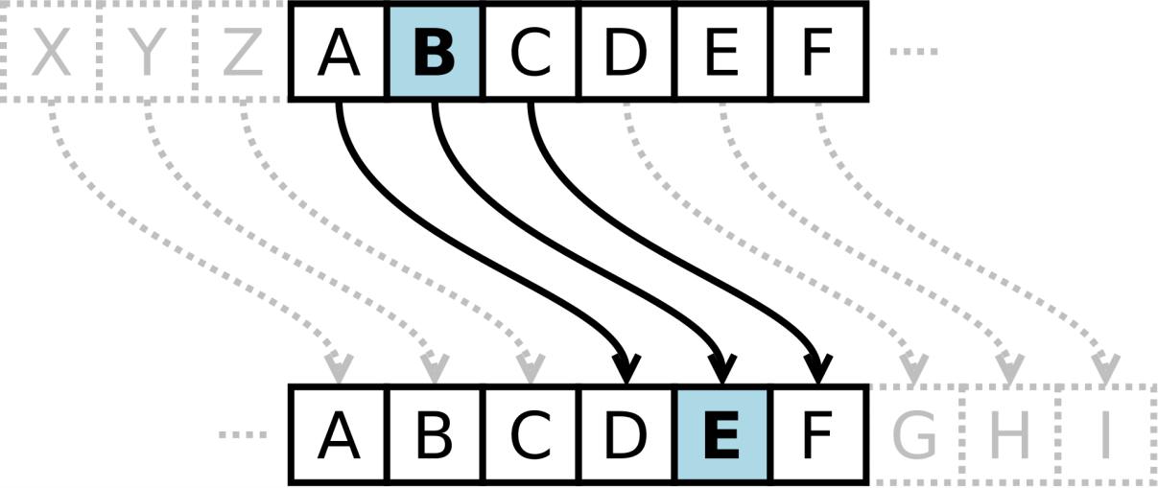
The main algorithm
I chose the usual Caesar cipher algorithm with key, since:
It's simplicity to encrypt and decrypt
easy to implement in a programming language

Slide 4
Explanation of the algorithm
Read the file and record its contents in a text type, and then convert it to an array of characters.
Get the key value.
perform encryption or decryption by writing the changed text to a new file.
view the contents of the newly created file.

Slide 5
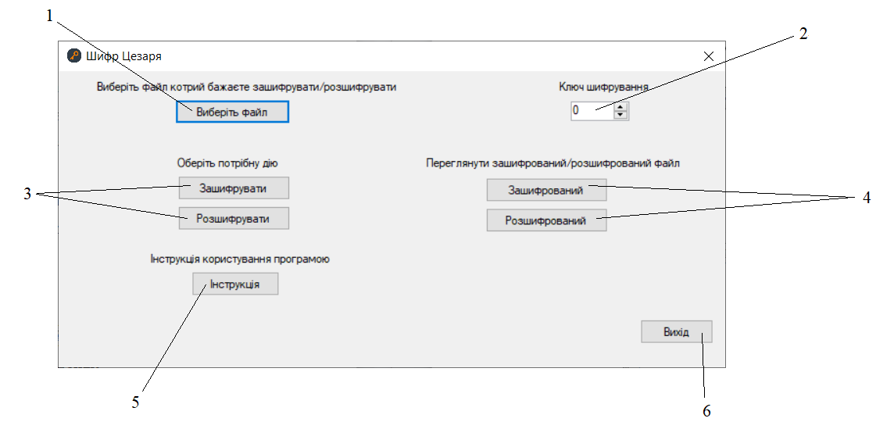
The user interface
Button “Select the file”
select a number from a certain range
Buttons “Encrypt” and “Decrypt”
Buttons “Encrypted” and “Decrypted”
Button “Instruction”
Button “Exit”

Slide 6
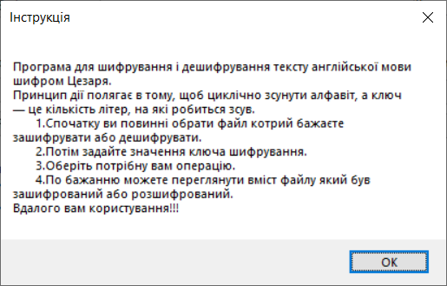
Button “Instruction”
It is suggested to create a "Instruction" button to facilitate the work of the program for new users.

Slide 7
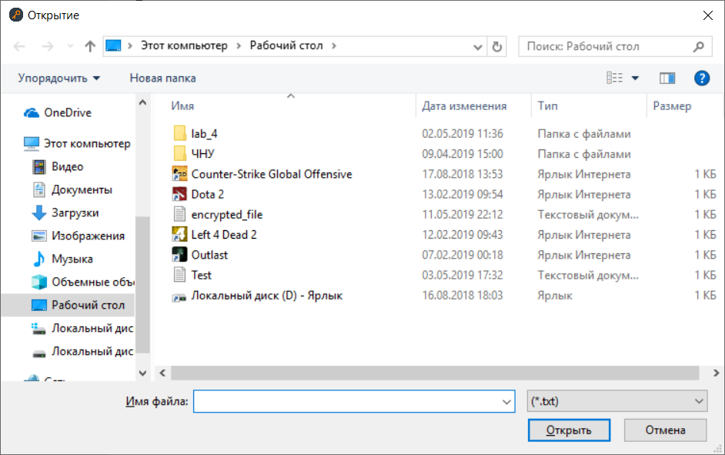
Demonstration of program
The original content of the file "hello world !!!"
Open the file for encryption

Slide 8
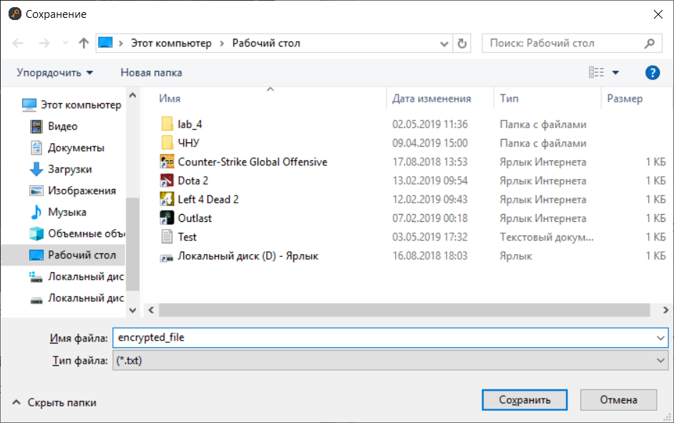
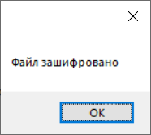
Demonstration of program
Set the key value
Press the "Encrypt" button

Slide 9
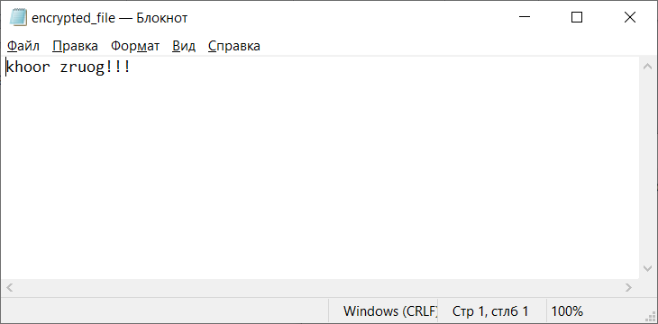
Demonstration of program
Press the “Encrypted” button

Slide 10
Conclusion
The created program gives the user the ability to easily work with encryption or decryption of the file by Caesar's algorithm.

Slide 11
Thanks for attention!

